Slide 1
Data Structures
H16Y 35

Slide 2
Part C: Static & Dynamic Memory Allocation (SMA & DMA)

Slide 3
Memory Allocation – Intro.
Dynamic memory allocation is necessary to manage available computer memory.
For example, during compile time, we may not know the exact memory needs to run the program.
So for the most part, memory allocation decisions are made during the run time
A C programmer must manage all dynamic memory used during the program execution
Note:
The <stdlib.h> provides four functions that can be used to manage dynamic memory.
The four functions used by C program to allocate and to free dynamic memory are: calloc, malloc, free, & realloc

Slide 4
Memory Allocation in Computer Programming.
Generally, computers are made up of physical components consisting of large numbers of transistors used for storing information/data.
Computer memory can be allocated prior to initializing programming or while the programming is done (i.e. at run time)
In computer programming, there are two main methods used for creating and allocating free memories to computers;
Static Memory Allocation (SMA)
Dynamic Memory Allocation (DMA)

Slide 5
Memory Allocation – Cont’d
Memory allocation involves calling/requesting for memory block to perform specific operation or storing information in computer programming.
In computer programming, memory can either be allocated prior to run time in which case the allocated memory remain fixed (i.e. static) or allocated during run time in which case the memory can be changed (i.e. dynamic memory allocation).
When memory allocated is fixed (i.e. SMA), the compiler will not be able to allocate or deallocate memory during the execution of a program.
When SMA is used, it is not is not possible to predict how much memory will be needed by the program at run time.
For Example: Assume we have declared an array with size 20 elements, which is fixed. So if at run time, values to be stored in array is less than 20 then there will be wastage of memory or the program may fail if more than 20 values are to be stored in to that array.
Note:
In order to solve the above problems and allocate memory during runtime, we would have to apply dynamic memory allocation – DMA.

Slide 6
Static Memory Allocation – SMA.
Static Memory Allocation (SMA):
This is when memory is allocated for the declared variable by the compiler.
The address can be obtained by using ‘address of’ operator and can be assigned to a pointer.
The memory is allocated during compile time. Since most of the declared variables have static memory, this kind of assigning the address of a variable to a pointer is known as static memory allocation.
Note:
Static memory is pre-allocated during process mapping into the main memory
In SMA, the memory is allocated when the program starts and once allocated it usually remain fixed.

Slide 7
Static Memory Allocation – SMA. (Summary)
Static Memory Allocation (SMA):
Done at compile time.
Global variables: variables declared “ahead of time,” such as fixed arrays.
Lifetime = entire runtime of program
Advantage
Efficient execution time.
Disadvantages
If we declare more static data space than we need, we waste space.
If we declare less static space than we need, we are out of luck.

Slide 8
Dynamic Memory Allocation – DMA.
Dynamic Memory Allocation (DMA):
This is involves the allocation of memory at the time of execution (i.e. run time) of particular operation.
DMA uses the functions calloc() and malloc() to dynamically allocate computer memory space during compilation time in computer programming (C#).
Dynamic allocation of memory space is done by using these functions when value is returned by functions [i.e. calloc() & malloc()] and assigned to pointer variables.
DMA allows the compiler to dynamically allocate only the amount of memory needed to perform an operation.
Note:
Dynamically allocated memory must be referred to by pointers.
Dynamic memory is allocated on heap space of the process map
In DMA, the compiler controls the exact size and the lifetime of the memory allocated.
The compiler may choose to free some space by cutting back on the memory allocated from time to time.
In C# program, memory can be dynamically allocated by using the following functions:
Malloc, calloc, realloc…

Slide 9
Dynamic Memory Allocation – DMA. (Cont’d)
Dynamic Memory Allocation (DMA):
Done at run time.
Data structures can grow and shrink to fit changing data requirements.
We can allocate (create) additional storage whenever we need them.
We can de-allocate (free/delete) dynamic space whenever we are
Advantage
we can always have exactly the amount of space required - no more, no less.
For example, with references to connect them, we can use dynamic data structures to create a chain of data structures called a linked list.

Slide 10
Dynamic Memory Allocation – DMA. (Cont’d)
Local Variables
Lifetime = duration of procedure activation (as long as that method is active).
Advantage: efficient storage use.
Stack Allocation (all variables allocated within the procedure scope unless declared static).
For example, parameter passing during function calls.
User - Allocated Variables
Lifetime = until the user deletes it (or until it is garbage-collected).
Advantage: permits creation of dynamic structures like trees, linked lists etc..
Heap Allocation
For example, Linked lists.

Slide 11
Dynamic Memory Allocation – DMA. Functions
1. malloc()
Declaration: void *malloc(size_t size);
This function is used to allocate memory dynamically.
The argument size specifies the number of bytes to be allocated.
On success, malloc() returns a pointer to the first byte vof allocated memory.
The returned pointer is of type void, which can be type cast to appropriate type of pointer.
The memory allocated by malloc() contains garbage value
2. calloc()
Declaration: void *calloc(size_t n,size_t size);
This function is used to allocate multiple blocks of memory
The first argument specifies the number of blocks and the second one specifies the size of each block.
The memory allocated by calloc() is initialized to zero.
Generally it allocates space for an array of elements, initializes them to zero and then returns a pointer to the memory.

Slide 12
Dynamic Memory Allocation – DMA. Functions
3. realloc()
Declaration: void *realloc(void *ptr,size_t newsize);
The function realloc() is used to change the size of the memory block
It alters the size of the memory block without losing the old data.
This function takes two arguments, first is a pointer to the block of memory that was previously allocated by mallloc() or calloc() and second one is the new size for that block.
4. free()
Declaration: void free(void *p);
This function is used to release the memory space allocated dynamically
The memory released by free() is made available to the heap again and can be used for some other purpose
We should not try to free any memory location that was not allocated by malloc(), calloc() or realloc()

Slide 13
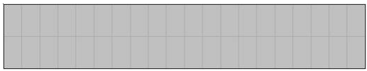
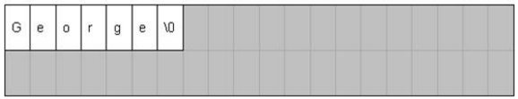
Dynamic Memory Allocation – DMA.- Illustration
Let’s assume that all the memory on the programme is currently free
We want to create memory using strings to store the name ‘George’
If we assume that each character in the string will require a space size of 1 byte, so in this instance we are storing 6 characters so we need six bytes.
We also need a character at the end to indicate the end of the string, which will always take up one byte
In C this is called the 'NUL' character and is written "\0“
We, therefore would require 7 bytes in order to store the information
In C we would request this memory by calling the malloc() function.

Slide 14
Static vs. Dynamic Memory Allocation
:
SMA | DMA
Fixed in Size | Change in Size
Performed at static or compile time | Performed at dynamic or run time
Assigned to stack (also known as Stack memory) | Assigned to heap (also known as heap memory) * Can also assign to Stack
Size must be known at compile time | Size may be unknown at compile time
First in Last out (FILO) | No particular order of assignment
It is best if required size of memory is known in advance | It is best if we don’t have idea about how much memory is required/needed

Slide 15
Dynamic Memory Allocation (DMA) – Example 1
Task:
Dynamically allocate memory for
10000 integers to perform a given task and after completing the task, de-allocate the memory to recycle it.
Solution (Part A):
Note – To execute the above function in C programme, we would require pointer variable instead of normal variable.
Example of pointer variable: symbol * (asterisk) shows pointer variable declaration
Step 1
Declare ‘data’ as integer pointer
int * data;
Step 2
Use the malloc() and sizeof() functions to create the memory for the integer and the size required (i.e. bytes) to store the information
data = (int *) malloc (10000 * sizeof(int));
Note:
malloc() function returns void pointer, so need to convert into our destination type, which is integer
Above statement will allocate memory for 10000 integers and ‘data’ pointer will point to first block of allocated memory.
Part B:
Next task is de-allocation of memory
Step 3
We will use free() function to de-allocate memory.
free(data);
----------------------------------------------
Note
The above function will de-allocate the memory for reuse, but still ‘data’ pointer will points to that memory location
In this case, the ‘data’ pointer is referred to as a dangling pointer because it is still pointing to the memory even though it is de-allocated
Dangling Pointer - is a pointer which is pointing to nothing
Step 4
To remove the dangling pointer, we use the statement below.
data = NULL;
Note:
The above statement will remove dangling pointer that means ‘data’ will point to null instead of any random memory.

Slide 16
Dynamic Memory Allocation (DMA) – Example 1 - Summary
Task:
Dynamically allocate memory for 10000 integers perform a given task and after completing the task, de-allocate the memory to recycled it.
Solution – C# Program Statement
int * data;
data = (int *) malloc (10000 * sizeof(int));
free(data);
data = NULL
These statements creates/allocates the
memory
These statements free/de-allocate the
memory

Slide 17
Dynamic Memory Allocation (DMA) – Methods
DMA Ways/Methods
Heap Allocation
When program allocate memory at runtime using calloc and malloc function, then memory gets allocated in heap.
When some more memory need to be allocated using calloc and malloc function, heap grows upward
Stack Allocation
Stack is used to store your local variables and is used for passing arguments to the functions along with the return address of the instruction which is to be executed after the function call is over.
When a new stack frame needs to be added (as a result of a newly called function), the stack grows downward.
:

Slide 18
DMA – Methods
Stack Allocation
Used to allocate local variables.
Grown and shrunk on procedure calls and returns.
Register allocation works best for stack-allocated objects.
Heap Allocation
Used to allocate dynamic objects.
Heap objects are accessed with pointers.
Never allocated to registers.

Slide 19
DMA – Stack Based Allocation
Memory allocation and freeing are partially predictable.
Restricted but simple and efficient.
Allocation is hierarchical: Memory freed in opposite order of allocation.
For Example:
If alloc(A) then alloc(B) then alloc(C), then it must be free(C) then free(B) then free(A).

Slide 20
DMA – Stack Based Allocation - Example
Procedure call:
Program calls Y, which calls X. Each call pushes another stack frame on top of the stack. Each stack frame has space for variable, parameters, and return addresses.
Stacks are also useful for tree traversal, expression evaluation, top-down recursive parsers etc.

Slide 21
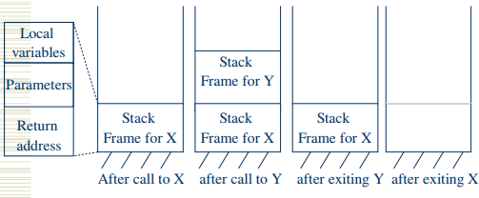
DMA – Stack Based Allocation - Example
A stack-based organization keeps all the free space together in one place..

Slide 22
DMA – Heap Based Allocation
Allocation and release are unpredictable.
Heaps are used for arbitrary list structures, complex data organizations.
More general, less efficient.
Example: payroll system.
Do not know when employees will join and leave the company.
Must be able to keep track of all of them using the least possible amount of storage.

Slide 23
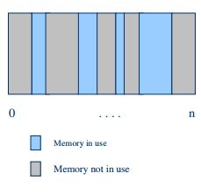
DMA – Heap Based Allocation
Memory consists of allocated areas and free areas (holes).
Goal
Reuse the spaces in holes.
Keep the no. of holes small.
Keep the size of holes large.
Problem: Fragmentation!!
Inefficient Holes may be too small to be useful for any allocation.
use of memory.

Slide 24
Problems with DMA
Common problems associated with dynamic memory allocation (DMA) in programming are listed as follows;
Memory Leak
Dangling pointer
Memory fragmentation
Time consuming
Memory de-allocation

Slide 25
Memory Management
The memory of a process is divided into the following parts
A space for the code of the program
A space for the data (global variables)
The stack, for the local variables (static allocation)
The heap, for the dynamic variables (dynamic allocation)
The division between 1 and 2 is only logical: physically the globals and the code are placed at the base of the stack.

Slide 26
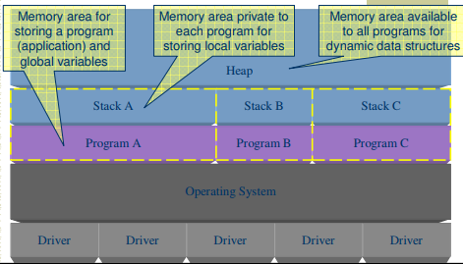
Logical Memory Components

Slide 27
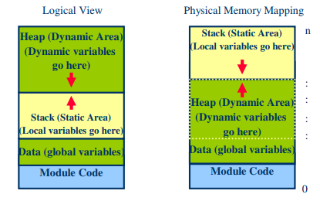
Memory of a Process

Slide 28
Class Exercise
Question
Carry out research using referenced and online resources to briefly describe the following and state their uses during programming (in C# environment).
Local Variables
User-Allocated Variables
Pointers

Slide 29
Resources - Links
http://datastruct.hnd-computing.info/
https://www.tutorialspoint.com/csharp/csharp_data_types.htm

